Slide 1
SmartDeliveryRoute Backend
Role: Backend & API Developer
Presenter: Tejas Thakor

Slide 2
The Problem & My Solution
Problem: Traditional logistics suffer from lack of visibility and manual dispatching errors.
My Solution: A centralized REST API architecture that connects Drivers and Admins in real-time.
Core Contribution: Built the 'Nervous System' of the app using Spring Boot.

Slide 3
Technical Stack
Framework: Java Spring Boot (MVC, Dependency Injection).
Database: MongoDB (NoSQL for high-speed writes).
Tools: Maven (Build), Postman (API Testing).

Slide 4
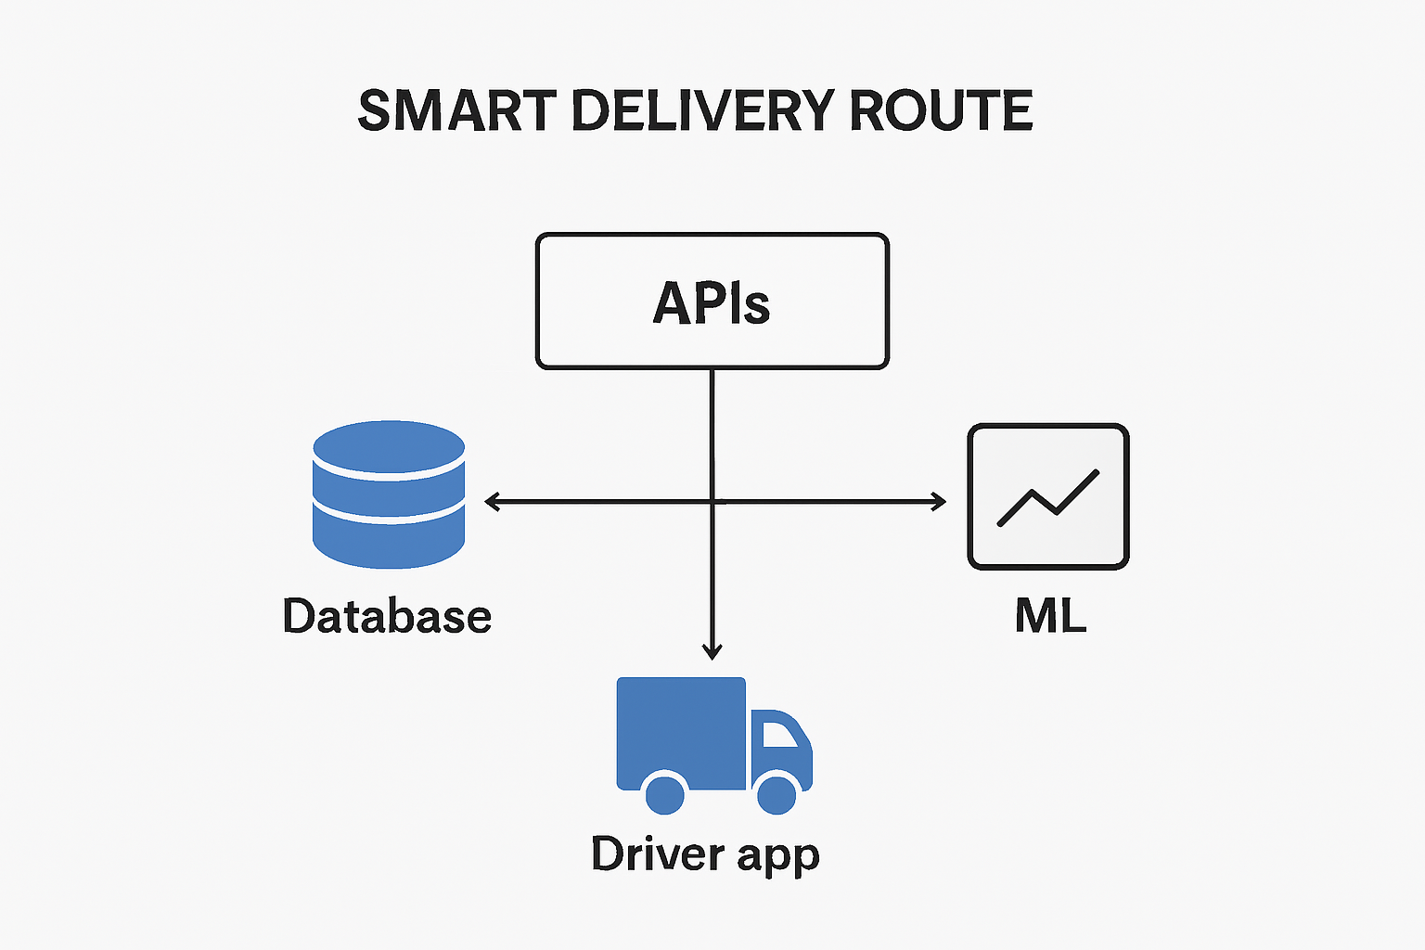
Backend Architecture
Pattern: Controller-Service-Repository.
Data Flow:
- Client sends HTTP Request.
- Controller routes to Service.
- Repository talks to MongoDB.
- JSON response returned.

Slide 5
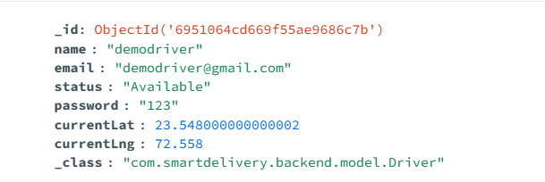
Database Schema (MongoDB)
Designed a schema optimized for
real-time updates.
Drivers Collection: Holds status,
vehicle, and vital
currentLat/Lng fields.
Orders Collection: Tracks
Customer, Price, and Status.
Flexible schema allows easy updates to driver telemetry.

Slide 6
The 'Live Tracking' Engine
This is the most complex backend logic.
Mechanism: Polling Architecture (5-second intervals).
Step 1: Driver hits /update-location (POST).
Step 2: Backend overwrites coordinates in DB.
Step 3: Admin hits /driver-location (GET).
Result: Admin map updates instantly without page refresh.

Slide 7
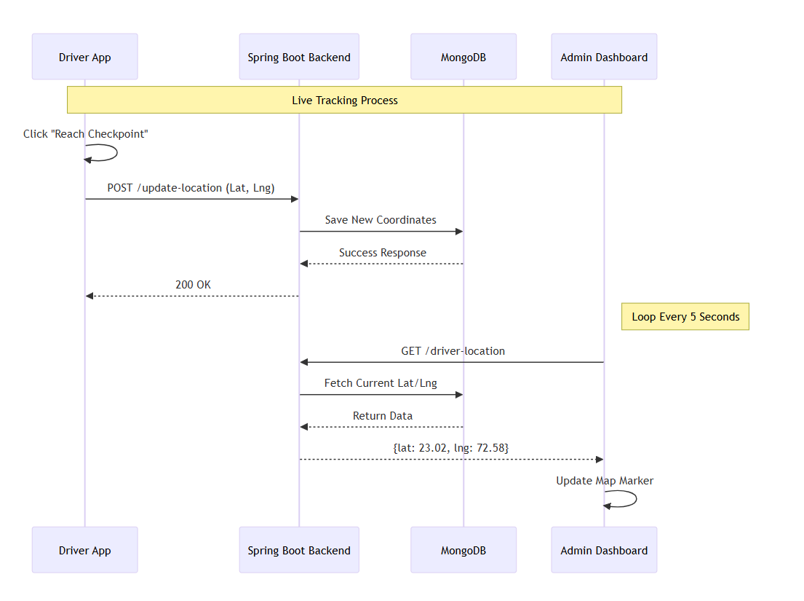

Slide 8
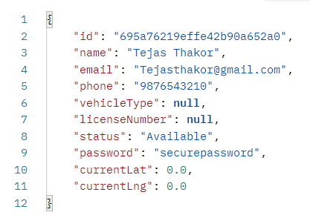
API Endpoints Developed
POST /api/drivers/create – Onboard
new fleet members.
POST /api/orders/create – Generate
delivery missions.
POST /api/assign - Link an Order to
a Driver.
GET /api/admin/stats – Calculate
daily revenue and active drivers.

Slide 9
Analytics & Logic
Implemented Business Logic to filter data.
Date Filtering: Backend specifically filters Delivered orders by LocalDate.now() to show accurate 'Today Stats'.
Status Logic: Enforced state transitions (Order cannot be 'Delivered' before it is 'Picked Up').

Slide 10
Conclusion
Successfully architected a scalable backend handling real-time data.
Enabled seamless synchronization between Admin and Driver apps.
Future Scope: Move from Polling to WebSockets for sub-second updates.

